Slide 1
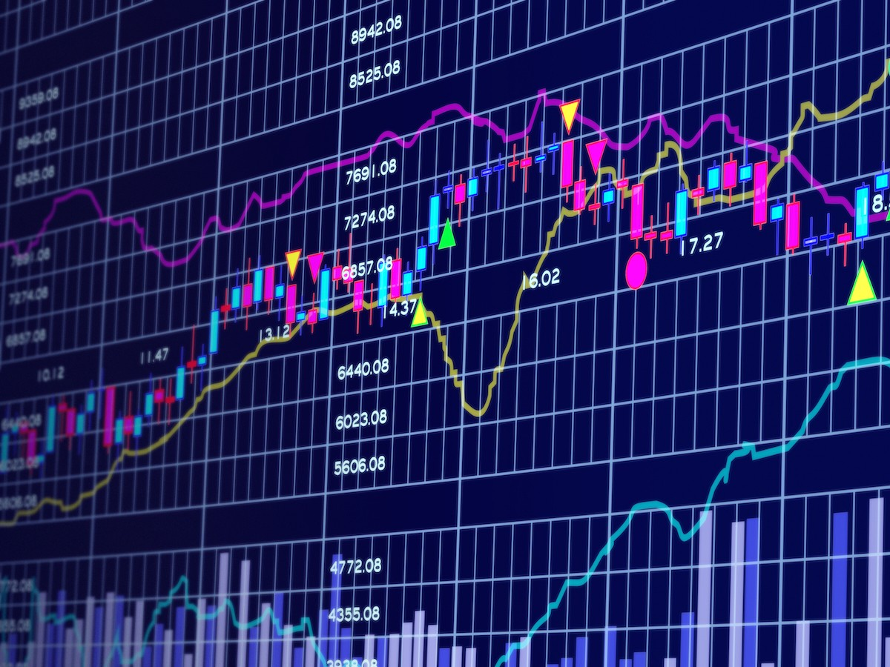
Technical Stock Analysis of FAANG Companies
By: Team 10
Neeharika Kamireddy, Luca Matteucci, Honglin Jiang, Ruiqi (Freya) Jiang, Yuanshan (Olaf) Zhang, Chirayu (Mitthi) Jain

Slide 2


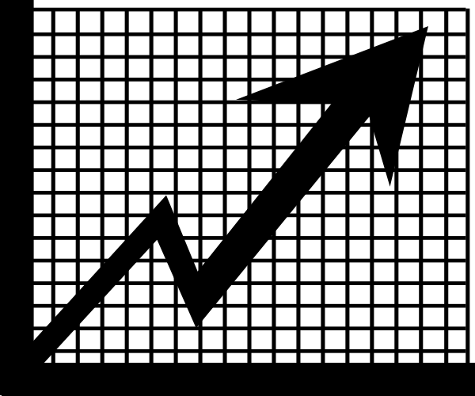
Navigating the Financial Maze
Imagine you are a trader/asset manager trying to analyze a decade’s worth of FAANG data
Vast amounts of data, and having to identify trends, can be overwhelming
We built a dynamic dashboard to streamline this process for traders
Notes:
Imagine you're a trader or an asset manager navigating the dynamic landscape of FAANG stocks over the past decade. The vast sea of data, coupled with the challenge of identifying trends and seizing timely opportunities, can be overwhelming. Recognizing this challenge, our team has embarked on a mission to address a critical need in the financial industry. We proposed to build a dynamic dashboard for traders and asset managers, focused on FAANG stocks (Meta, Apple, Amazon, Netflix, Google) over the past decade. This interactive tool integrates stock prices and technical indicators, aiding in trend identification. Developed in the 1950s, these indicators offer valuable signals based on historical trading data. Our goal is to enable traders to visualize these patterns and identify trading opportunities.

Slide 3
From Data to Decisions: The Impact of Our Innovative Tool on Traders
Visualize Patterns
Live Decision Support
Identify Opportunities
Intuitive interface to visualize complex historical patterns and trends in FAANG stocks, aiding in a more comprehensive understanding of market movements
With integrated technical indicators, the dashboard offers real-time insights, enabling users to make informed decisions on entry and exit points, risk management, and overall portfolio optimization.
Identify and capitalize on trading opportunities:
spotting emerging trends
understanding market sentiment
adapting strategies to changing conditions
Notes:
Enhanced Visualization of Patterns:
"One of the primary ways our dynamic dashboard supports traders is by offering an enhanced visualization of historical patterns and trends in FAANG stocks. Through an intuitive interface, users can easily navigate and comprehend complex market movements, gaining a deeper understanding of the data at their fingertips."
Real-time Decision Support:
"Our dashboard goes beyond mere visualization; it acts as a real-time decision support system. By integrating live stock prices and proven technical indicators developed in the 1950s, users receive instantaneous insights. This functionality empowers traders and asset managers to make timely decisions on entry and exit points, refine risk management strategies, and optimize their overall portfolio in response to dynamic market conditions."
Strategic Opportunity Identification:
"In the fast-paced world of trading, identifying strategic opportunities is crucial. Our dynamic dashboard serves as a strategic ally by transforming raw data into actionable insights. Whether it's spotting emerging trends, understanding market sentiment, or adapting trading strategies to changing conditions, the dashboard equips users with the tools to identify and capitalize on valuable trading opportunities."

Slide 4
Snapshot Of Our Dataset
Column | Description
fclose | Fully adjusted for historical dates. Close price.
fhigh | Fully adjusted for historical dates. Highest price point in the day.
flow | Fully adjusted for historical dates. Lowest price point in the day.
fopen | Fully adjusted for historical dates. Open price.
symbol | Unadjusted data for historical dates.
aroon_osc | Aroon Oscillator measures how recently a high or low has occurred
macd_line | Moving Average Convergence Divergence (MACD) line represents the difference between short-term and long-term Exponential Moving Averages (EMAs)
rsi | Relative Strength Index
obv | On-Balance Volume
Notes:
This is a snapshot of our data, and is not an exhaustive list of all the columns. Some columns, like ‘fclose’, ‘fhigh’, and ‘fopen’ were part of our original dataset, and indicators such as ‘aroon_osc’, ‘macd_line’, ‘rsi’ and ‘obv’ were calculated using SQL queries.

Slide 5
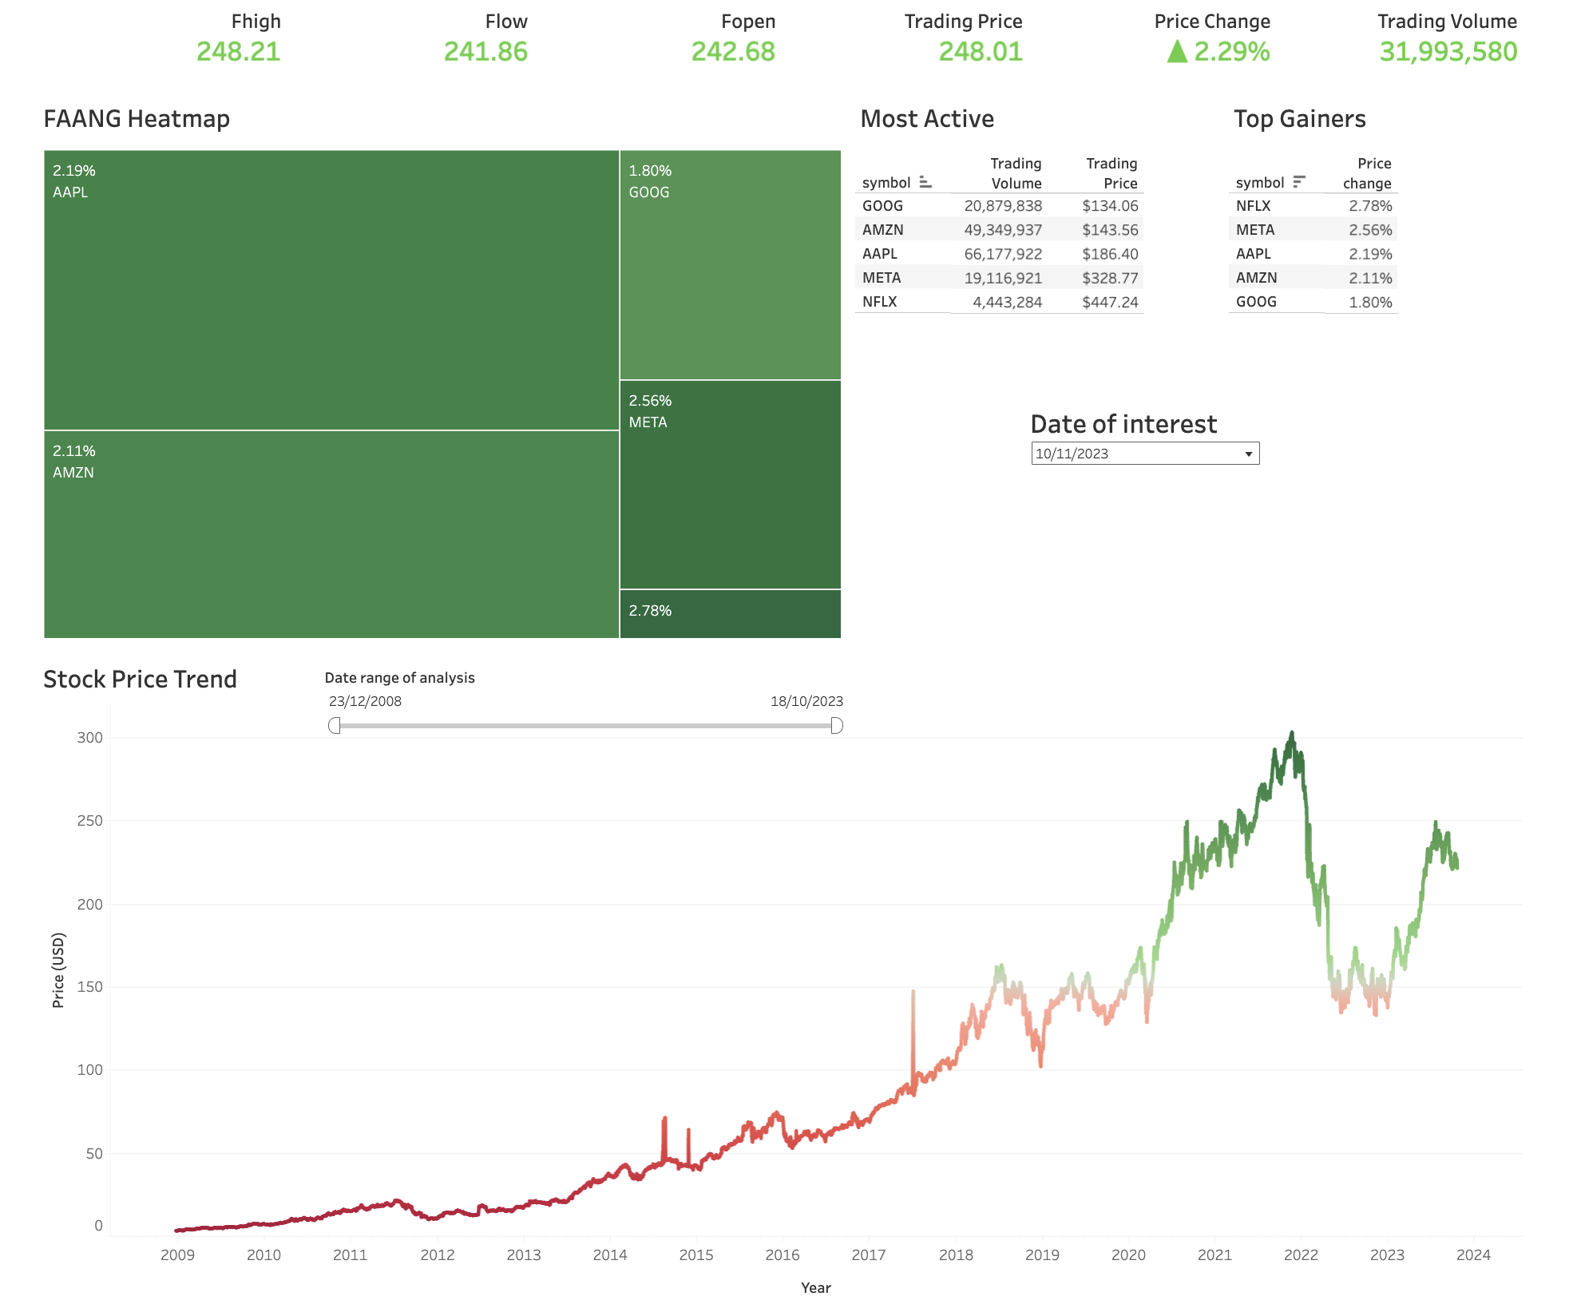
Stock Price Data Dashboard
Check out the last day of trading of the faang portfolio
Find what happen in the last period whether in general or
for specific stock
Find a day of interest and observe trading volume and top gainers
Notes:
As Mitthi said, the market is a tough terrain to navigate with scattered information. That’s why we created this dashboard using FAANG portfolio as an example to showcase how neatly aggregated market information could help investors identify potential upside and risk.
Our dashboard are composed of two parts, the first dashboard gave a portfolio level overview and the second dashboard drilling into stock signals.
Here on the first dashboard, the portfolio overlook are sliced by a point in time and over a period of time. On the top, user are given a market level summary with fully adjusted open, high, low data and daily price change. Then we pinpoint specific top driver for portfolio performance and stocks that are getting most interest on the street, here in table and heatmap.
And on the bottom, we gave a performance period recap, customizable by user for any potential monthly and quarterly review they may wish to run.
And now Luca will show you how an investor could use this dashboard to analyze their portfolio.

Slide 6
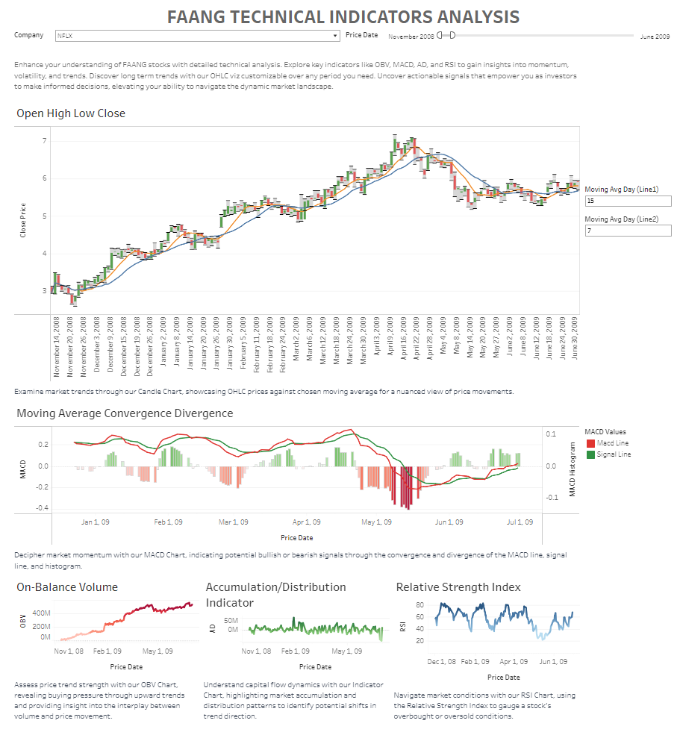
Technical Indicator Dashboard
Elements:
FAANG stock prices
Open High Low Close
Technical indicators
Moving Average Convergence Divergence
On-Balance Volume
Acllllcumulation/Distribution Indicator
Relative Strength Index
Intentions:
Market Monitoring
Indicator Signals

Slide 7
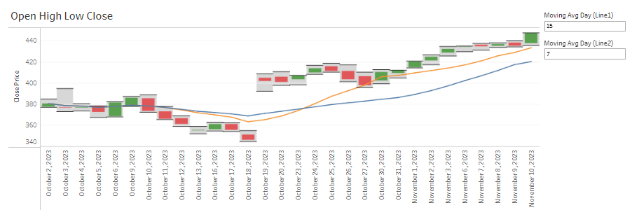
Technical Indicator Dashboard
the daily high, low, open, and close prices of a chosen stock within a selected time frame
interactive moving average lines helps identify trends and breakout points for future predictions

Slide 8
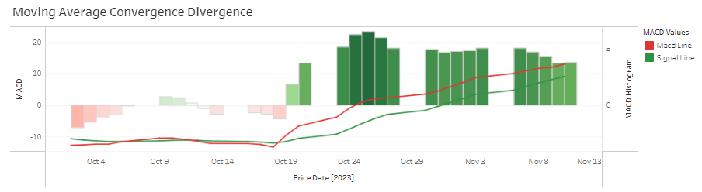
Technical Indicator Dashboard
Macd Line: represents the difference between two different periods (usually short-term and long-term) of exponential moving averages
Signal Line: the exponential moving average of the Macd line
Histogram: represents the difference between the Macd line and the Signal line

Slide 9
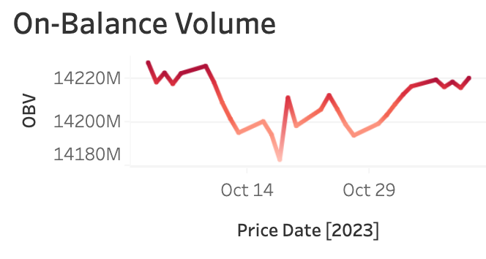
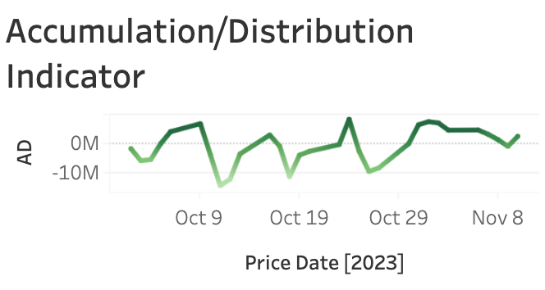
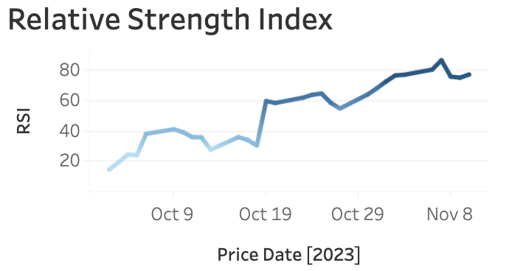
Technical Indicator Dashboard
• trading volume can indicate the trend of stock prices
• increase indicates stronger buying pressure
• decrease indicates stronger selling pressure
• consider trading volume, closing, and high-low fluctuations
• increase suggests money flowing into the stock, indicating accumulation
• decreasing suggests money flowing out, indicating distribution
• RSI ranges between 0 and 100
• above 70 is considered overbought
• below 30 is considered oversold
Notes:
OBV
In the field of finance, OBV stands for "On-Balance Volume". The core idea of OBV is that changes in trading volume can indicate the trend of stock prices. Specifically, when a stock's closing price rises, the trading volume of that day is added to the OBV; conversely, when the stock's closing price falls, the trading volume of that day is subtracted from the OBV. By this method, OBV acts as a measurement of the buying and selling pressure as a leading indicator of price movements.
A/D
Similar to the OBV, the Accumulation/Distribution indicator also takes into account trading volume, but it is more complex as it also considers the closing price and the high-low fluctuations of the price. The purpose of this indicator is to determine whether funds are flowing into (accumulating) or out of (distributing) a stock.
RSI
The Relative Strength Index (RSI) is widely used to measure the momentum of the price and potential trend reversal points. RSI is calculated by comparing the average number of points that the closing price has risen over a certain period with the average number of points that the closing price has fallen. The period length commonly used is 14 days.

Slide 10
Key Takeaways
On Nov 10, 2023, FAANG +2.29%: Netflix shines, Apple leads in liquidity
Upward trend: Netflix stock, positive moving averages and MACD signals
Late 2022, FAANG Portfolio surged
2022-2023: Downtrend, possibly influenced by COVID recovery and rising interest rates
Technical Indicators analysis helps find the best moment to buy/sell a stock

Slide 11
Challenges
01
Technical Indicators Dataset Format
Complex Excel Cell Formatting
Decision to Use Both Source Indicators and Calculated Ones
Data Integration Struggles
02
Vast and Diverse Dataset
Large Volume and Variety of Columns
High Complexity
Dealing with missing values - META and GOOG
Challenges in Handling FAANG Stock Data
03
Inefficiencies in Creating an Intuitive UI
Challenges Across Various Devices
Friction in Dashboard Creation Due to Limited Tableau Experience
Publishing dashboard from Desktop to Public
Dashboard Design and User Interface
04
Trial and Error in Tableau Features
Difficulty in Debugging Issues
Limited Tableau Documentation
Learning Curve and Problem Solving
Notes:
Our biggest challenge was definitely how vast and diverse a decade’s worth of FAANG stock data was. It was large in volume, with a variety of columns, and high complexity. It took us time and patience to interpret most of the data, since most of us aren’t financial experts, however, with the use of online resources we did get there with time. The data required robust data integration with another table- our second dataset, one with technical indicators, was formatted in a way that took us a lot of time to figure out. All indicators were formatted in a singular excel cell, in a row format. We reached out to the TA for expert help and were luckily able to figure out how to fix the format, we also decided that using some indicators from the data source and calculating some ourselves would because it could help us decide a flow/storyline for our project. Mention Meta IPO in 2013, GOOG vs GOOGL choice: we chose GOOG which is the saving stock with no participation rights
While creating the dashboard, we learned that designing an intuitive user interface across various devices proved to be mostly inefficient and we tackled this by sitting down together as a team for a day to tackle all of our issues together, on fewer devices. Even during this meeting, we faced a lot of friction in making our dashboard as most of us are new at using Tableau. We experienced lot of trial and error learning which features would help us the most, and often found it difficult to debug the issues, especially because the Tableau documentation seemed limited. We were able to tackle these issues with a lot of research and a productive working session as well as putting multiple minds together helped us get to the solution faster, and helped us finalize our dashboards. Finally, in the process of making our dashboard accessible to all, we had to compromise on a vast amount of data to make our dashboards publicly accessible.

Slide 12

THANK YOU

